Slide 1
Assignment 1
Stock Trend Prediction
CE6020* Artificial Intelligence (2024 Fall)
TA: ncu-ai-1131-ta@googlegroups.com

Slide 2
Task Description
Task:
Use 30 consecutive days stock data to predict the stock closing price trend after 1 day, 5 days, and 10 days.
The trend can be one of three labels: decline, unchanged, or rise,. The criteria are as follows:
decline: if the closing price decreases by more than 1% compared to day 30 (delta < -0.01)
unchanged: if the closing price change is within ±1% range
rise: if the closing price increases by more than 1% compared to day 30 (delta > 0.01)
Evaluation Measure: macro F1 Score
Data:
The data was scraped from FinMind, containing approximately 8 years of price data, along with 89 various financial indicators.
Every record contain 93 columns. See the columns detail in next page.

Slide 3
Original Data - Column Definition
date: The date, representing the date of each data entry.
close: The closing price, the stock price at the end of the trading day.
open: The opening price, the stock price at the beginning of the trading day.
high: The highest price, the maximum stock price during the trading day.
low: The lowest price, the minimum stock price during the trading day.
volume: The trading volume, the number of stocks traded during the day. Remaining 84 columns of financial indicators information can be viewed here
1_trend, 5_trend, 10_trend: These represent the trends after the corresponding number of days. You need to predict these 3 different labels. Values of [-1, 0, 1] correspond to [decline, unchanged, rise].
Contain 1862 days (~ 7 years) * 1 stock = 1862 rows

Slide 4
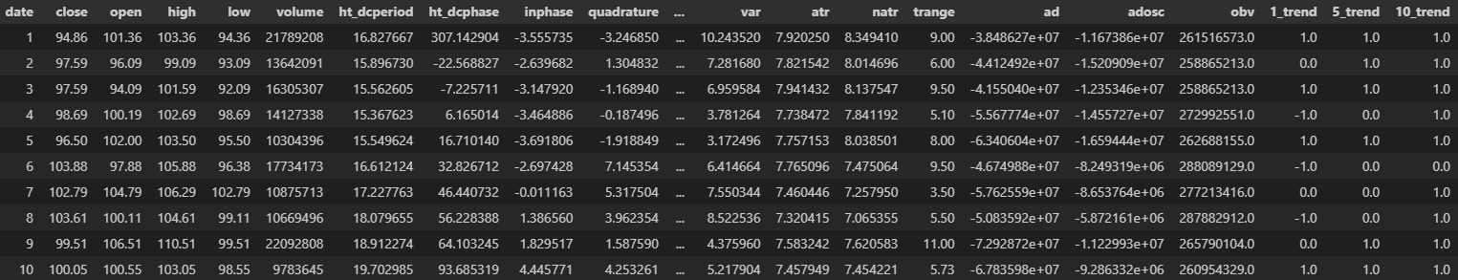
Original Data - Example
…
The data is sorted by "date". The picture shows 10 days data for 1 stock.
In addition to these 6 columns, there are 84 more features every day . You can select any of them as input features.

Slide 5
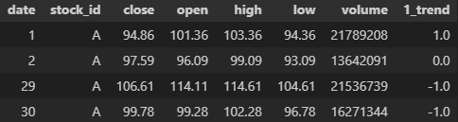
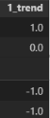
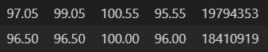
Design Matrix
 | Training | Testing
#examples | 1862 | 427
(Day 31-Day 30)
Day 30
Delta_31=
To simplify the training, you can train one model for each output label.
The input data will be (number of feature) * 30 days and the output is the closing price of Day 31st w.r.t. Day 30th.
Repeat the process for the 35th and 40th day, and train 1 model for each label.
The testing input is the same as the training input except for the output label.
…
Input_1→
...
Input_2→
...
Day 1
Day 2
Day 3~30
Trend_31

Slide 6
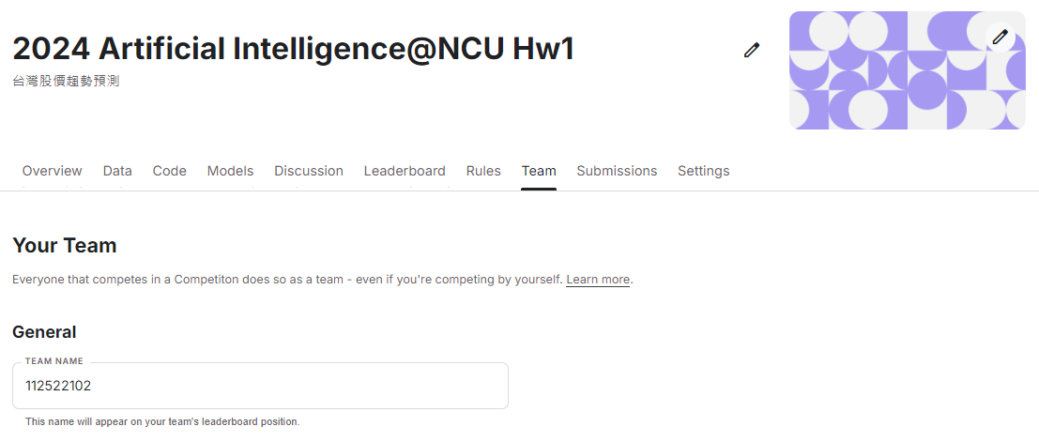
Kaggle
Please submit your prediction on Kaggle, this will affect your score for homework.
Link: 2024 Artificial Intelligence@NCU Hw1
Team Name: Student ID (e.g. 112525000)
You can select up to 5 submissions to count towards your leaderboard score.
You may submit up to 20 submissions per day.

Slide 7
Kaggle Submission Format
Example Output
id | trend
0
1
2
…
426
1_trend
After predicting the test data for each stock
Combine the results of the 3 model into 1 table.
Thus, there should be 3 x 427 = 1281 prediction results.
Submit the results in CSV format.
The first row must be “id, trend”.
Starting from the second row, each row should contain the id and the predicted trend category, separated by a comma.
The 'id' should be reset to range from 0 to 1280.
id | trend
0
1
2
…
426
5_trend
id | trend
0
1
2
…
426
10_trend

Slide 8
Grading Policy
 | Public Score | Hint | Score
Baseline | 0.373 | Sample Code | 55%
Programming (70%)
Top30: 55%~70% (1st place gets 70%, 2nd place gets 69.5%, and so on.)
>=Baseline: Get 55%
else: Get 0%
Bonus: Implement Deep Learning models 5% (Scores greater than 100 will be considered as 100.)
If your code use deep learning models like nn, lstm, rnn, then you can get bonus 5%.
This model does not need to be the one used for uploading results to Kaggle.
Report (30%)
Please output a PDF file in A4 size with the file name: report.pdf (not Report.pdf).
Format error -5%

Slide 9
Report (Template Link)
Use validation set to answer the following questions:
(5%) Explain the meaning of Precision, Recall, F1 score and discuss how it helps in understanding the performance of the model.
(5%) Preprocessing & Feature Engineering: What preprocessing (e.g. normalization) and feature engineering exhibit the better performance.
(5%) What models have you implemented? How do you modify these models to make them perform well on this task? What is the difference between these models? Please answer these questions.
(5%) Does longer history data present better performance? Say, using data from the previous 60 days versus the previous 30 days. Explain the possible reasons for the differences.
(5%) Compare performance of the 3 tasks for the next 1, 5, and 10 days.
(5%) Can we train three models together, e.g. multitasking? Compare the performance for independent training and parallel training.
You can use confusion matrix or probability distribution to analyze the performance in each class.

Slide 10
How to Submit your homework?
Please write a Python 3 program to predict the trends in the test dataset.
Upload the prediction results to Kaggle and try to surpass the baseline.
Please compress your files into a zip archive and upload it to the ee-class system.
Your StudentID.zip file should contain at least the following three types of files:
report.pdf Your report, output as a PDF in A4 size. Include your student ID and name, and answer the questions according to the assignment prompts.
main.ipynb or main.py The main program for training and testing.
README.md Explain your Python 3 version and instructions on how to execute the code.
You may include other files you need.
Deadline: 2024/10/6 23:30
You have 7 total late days grace period, max two per assignment (not for final project report, poster)
Late submission penalty: The grade for this assignment = Original grade × (1 – (days late × 0.1))

Slide 11
Sample Code
https://www.kaggle.com/code/hsiehchengwei/ce6020-hw1-code-example-svm
Try to modify the example code to improve your results.

Slide 12

Import Package
Scikit-learn is a widely used machine learning library in Python, offering a wide range of algorithms for tasks such as classification, regression, clustering, and dimensionality reduction. It also supports model evaluation and data processing tools.
In this case, we are using it's standardization, SVM model, classification report, confusion matrix, and f1_score.
from sklearn.preprocessing import StandardScaler
from sklearn.svm import SVC
from sklearn.metrics import classification_report
from sklearn.metrics import confusion_matrix
from sklearn.metrics import f1_score

Slide 13
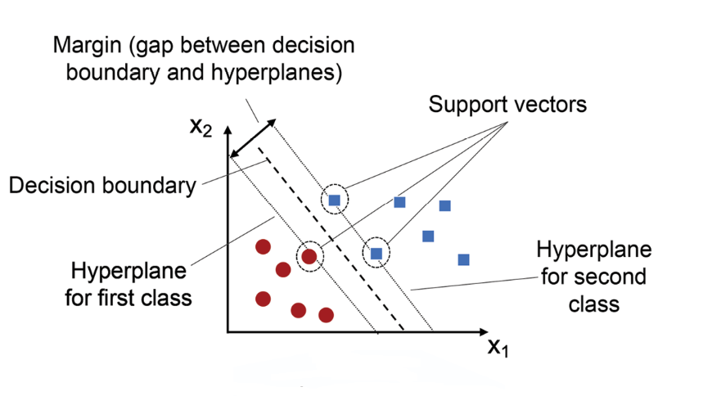
Support Vector Machine (SVM)
Support Vector Machine (SVM) is a supervised learning algorithm commonly used for classification and regression tasks. The goal of SVM is to find an optimal hyperplane that separates samples of different classes while maximizing the margin between the classification boundaries.

Slide 14
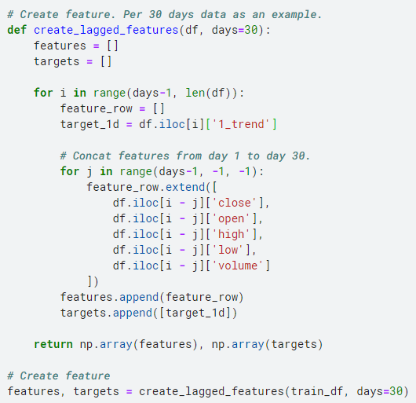
Preprocess
Function "create_lagged_features" will organize the data into a format that can be input to the model and a target array. Set your design matrix here, include feature selection or input days chosen.
The label is in the 30th day. We take "1_trend" from it as the target of model.
Take 30 consecutive days' features of the same stock and concat them into a 1-dim array. Therefore. the length of an input will be 30 * number of features (5 for this code).
Calling the function "create_lagged_features" to preprocess, we get 2 arrays contain features and targets for training.

Slide 15
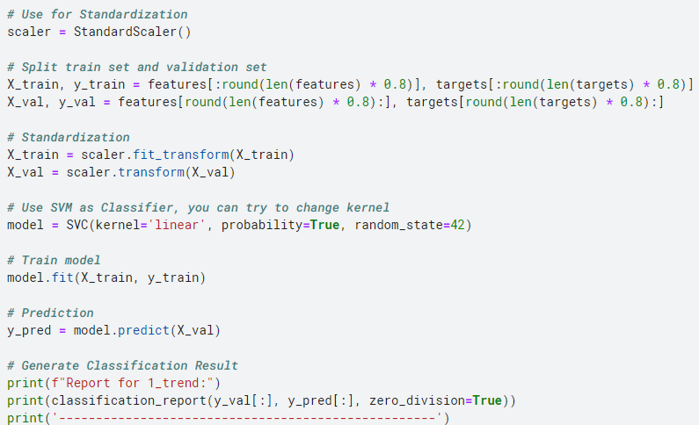
Training
In training stage, we will train 1 SVC model.

Slide 16
Training (1) - Split Train set & Validation set
Split data into train set and validation set. Don't split dataset randomly, the model need to predict label in future.

Slide 17
Training (2) - Declare SVM model
Declare the SVM model, and set a fixed random seed. For binary classification, use SVM instead.

Slide 18
Training (3) - Start Training
The model will attempt to compute support vectors and find the optimal classification boundary (hyperplane).

Slide 19
Training (4) - Predict on Validation set
Proceed with predictions by providing the validation data to the trained model.

Slide 20
Training (5) - Output Classification report
Output a prediction evaluation report, which will include scores such as precision, recall, and F1. Our leaderboard is scored based on macro F1.
The report can help identify issues with the model, such as bias towards a certain class or overfitting.

Slide 21
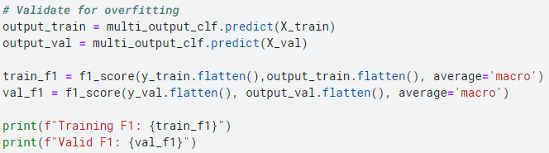
Checking for overfitting
The process here is used to see whether your model is overfitting. If your training score is a lot differ from valid score, then it is overfitting.

Slide 22
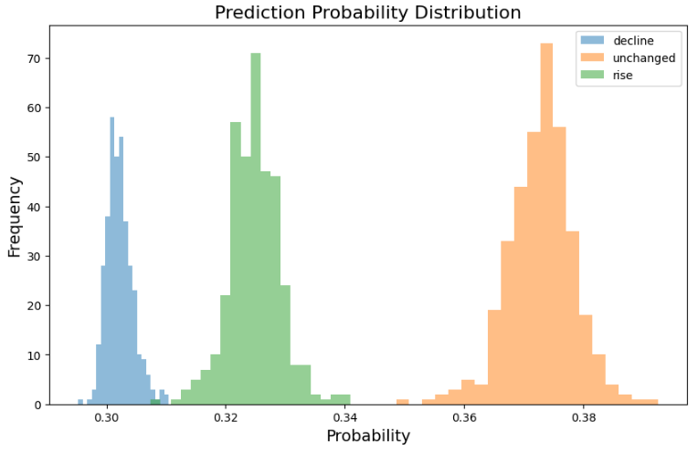
Chart drawing - Probability Distribution
Beware of the chart drawing specify 1 label.
In this chart you can find:
Confidence of Model
Distribution of different class
Bias and unbalanced data
Overfit or underfit
You can find model's or data's problem by analyze this chart.
Notes:
機率分布圖
1. 模型的預測信心
2. 類別間的分布情況
3. 偏差（Bias）與不平衡數據的影響
4. 過擬合或欠擬合
混淆矩陣
1. 呈現分類模型的預測情況
2. 錯誤類型的分佈
3. 不平衡數據

Slide 23
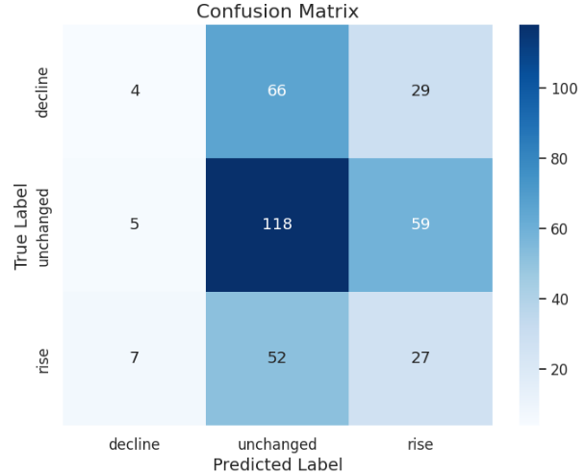
Chart drawing - Confusion Matrix
Beware of the chart drawing specify 1 label.
In this chart you can find:
Prediction status of model
Wrong prediction distribution
Unbalanced data
You can find model's or data's problem by analyze this chart.
Notes:
機率分布圖
1. 模型的預測信心
2. 類別間的分布情況
3. 偏差（Bias）與不平衡數據的影響
4. 過擬合或欠擬合
混淆矩陣
1. 呈現分類模型的預測情況
2. 錯誤類型的分佈
3. 不平衡數據

Slide 24
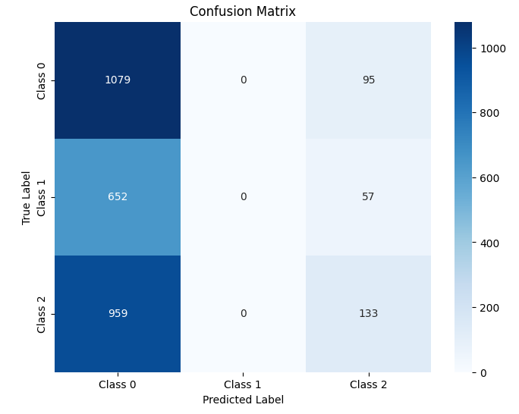
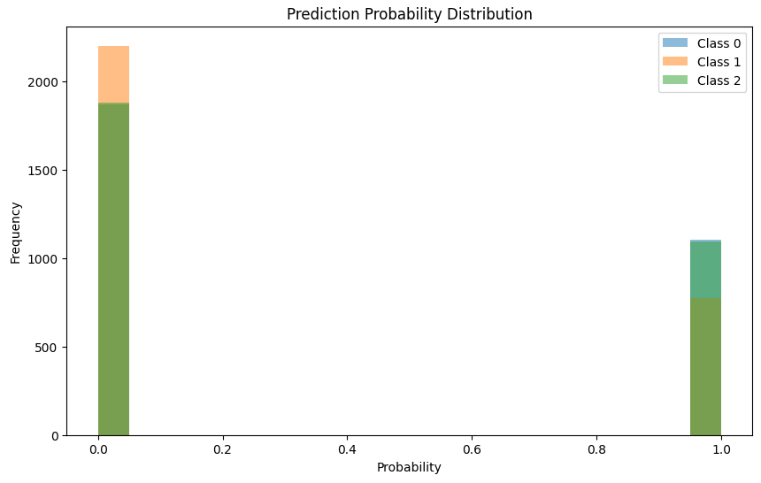
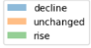
Chart drawing - Case of Training Problem
Prediction Unbalanced
Overfit

Slide 25
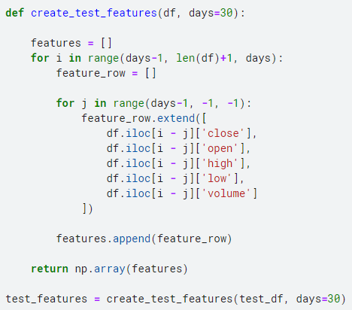
Testing - Preprocess
Preprocess of test data is only different in no label to prepeocess. Align your inputs as you designed in training preprocess.
The loop is executed "days" times to prepare the training example.
Calling the function "create_test_features" to preprocess, we get 2 arrays contain features and targets for training.

Slide 26
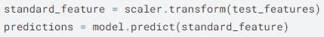
Testing - Prediction
The prediction process is easier than training. Remember to standardize the feature if you have done it in training.

Slide 27
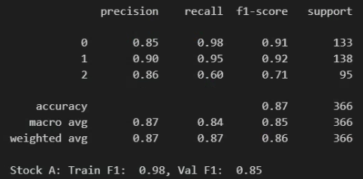
Model Performance Showcase
This is the highest performance for "1_trend" task that we have achieved on validation set.
The model is trainable, so don't give up in doing this work, Good luck!

